Slide 2
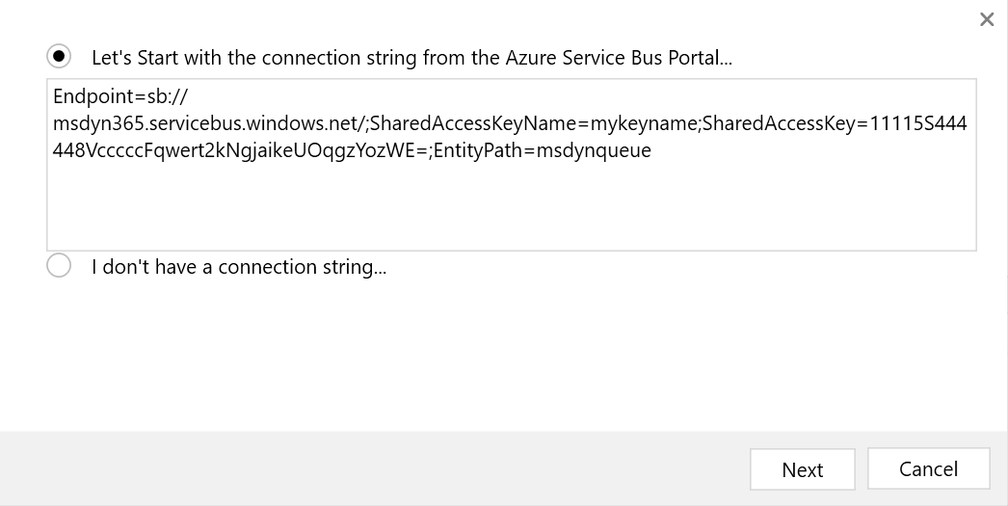
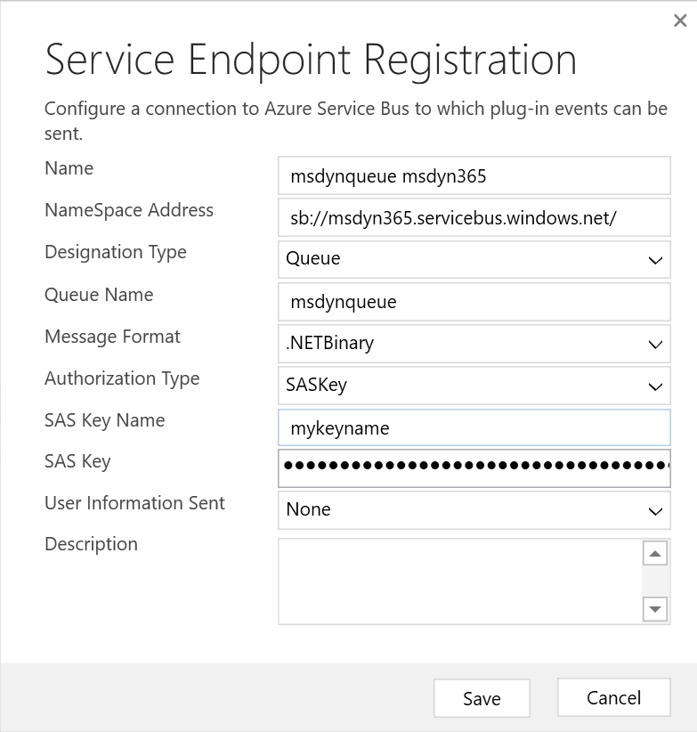
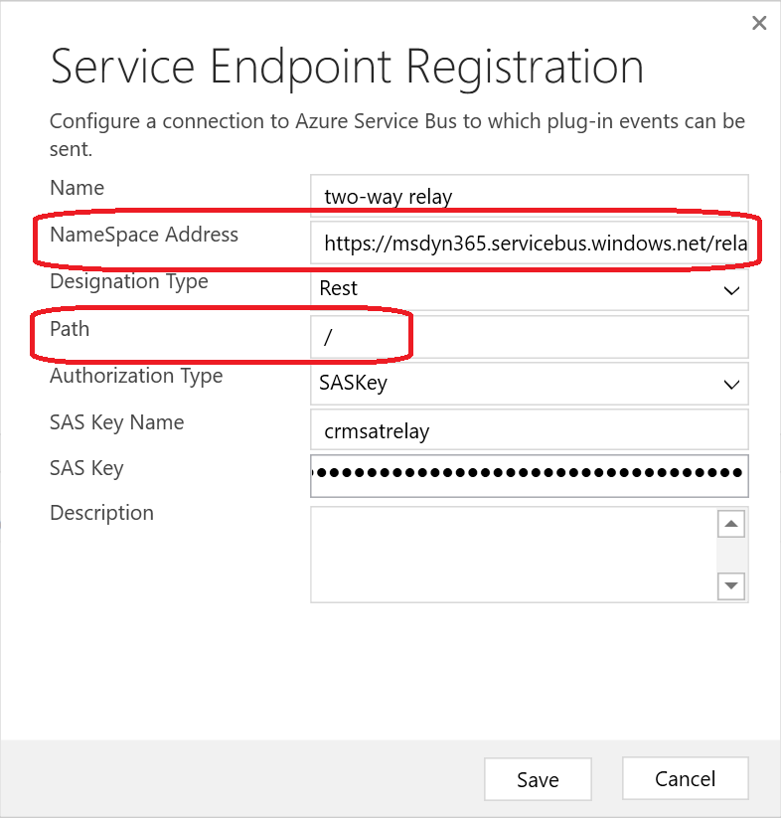
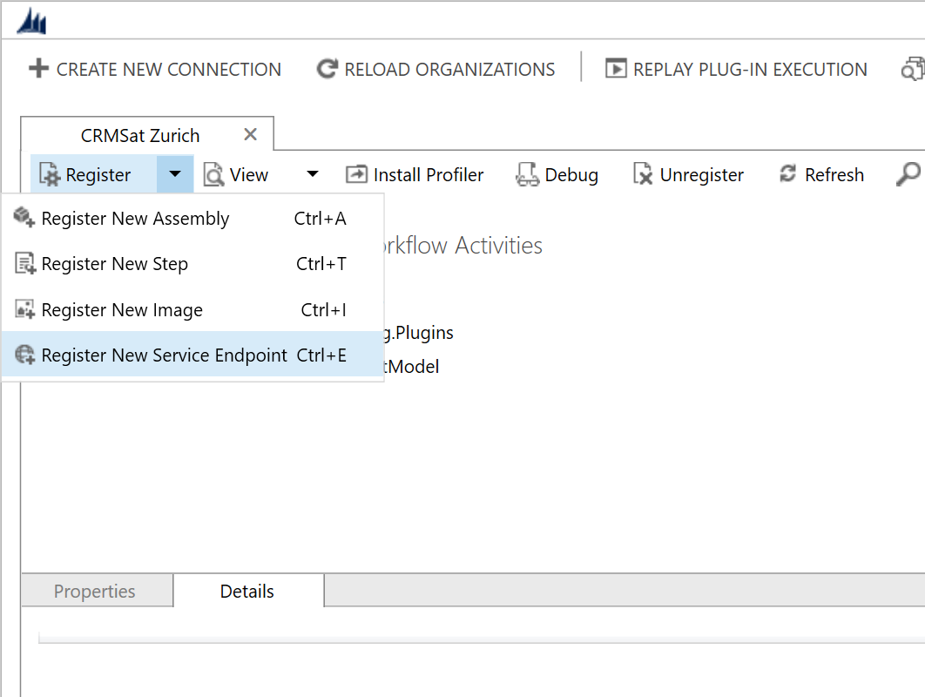
Register endpoint
Notes:
SAS is Shared Access Signature
SASKey is when you use a SAS key and signature to generate new tokens automatically in the background.
SASToken is when you use a pre-generated token, which is a hash of the URI and an expiration time signed with the key
Designation type is: queue, topic, one-way relay, two-way relay, REST Listener (REST based two-way relay), Event Hub
<number>

Slide 3
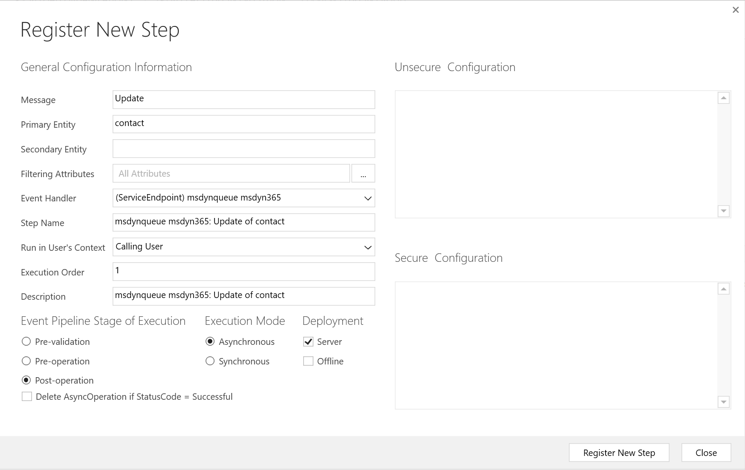
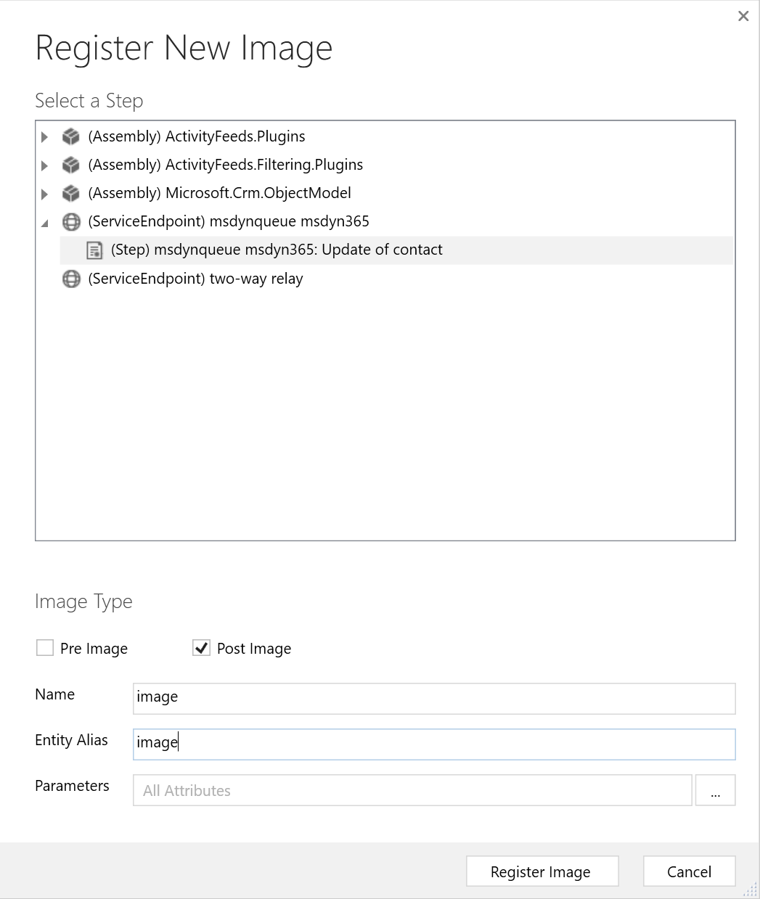
Adding steps and images to an endpoint

Slide 4
Using endpoints programmatically
VisualStudio!
Notes:
Demonstrate passing the context through workflow
Demonstrate workflow in MSDYN365
Demonstrate relay plugin

